Slide 1
PRESENTATION SKILLS
Umar Waqar Azim

Slide 2
Reasons to Speak and Present Effectively
Speaking skills rank very high on recruiters’ wish lists.
In a survey of employers, spoken communication took the top spot as the most desirable “soft skill” sought in job candidates. It even ranks above a strong work ethic, teamwork, analytical skills, and initiative.
Speaking skills are useful at every career stage.

Slide 3
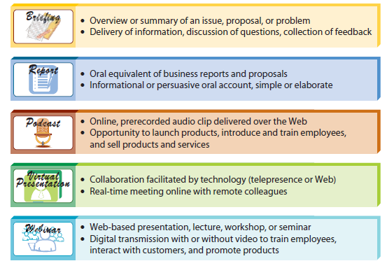
Presentation Types

Slide 4
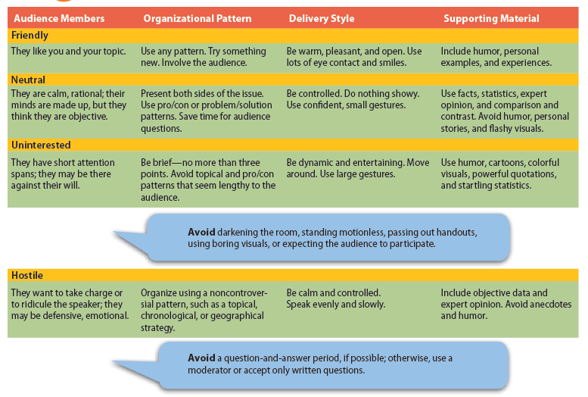
Audience Types

Slide 5
Organizing for Content the Introduction of a Presentation
Capture listeners’ attention and get them involved.
How: question, a startling fact, a joke, a story, a quotation, a question or a command that requires audience members to raise their hands or stand up.
Identify yourself and establish your credibility.
How: you need to describe your position, knowledge, or experience—whatever qualifies you to speak. In addition, try to connect with your audience.

Slide 6
Organizing Content for the Introduction of a Presentation
Preview your main points.
How: use bullet points or visual aids.

Slide 7
Organizing Content for the Body of a Presentation
The most effective oral presentations focus on a few principal ideas.
The body of your short presentation should include a limited number of main points—say, two to four.
Develop each main point with adequate, but not excessive, explanation and details.
Too many details can obscure the main message.

Slide 8
Organizing Content for the Conclusion of a Presentation
Nervous speakers often rush to wrap up their presentations because they can’t wait to flee the stage. However, listeners will remember the conclusion more than any other part of a speech.
Strive to achieve three goals:
Summarize the main themes of the presentation.
Leave the audience with a specific and memorable take-away.
Include a statement that allows you to exit the podium gracefully.

Slide 9
Organizing Content for the Conclusion of a Presentation
A conclusion is like a punch line and must be memorable.
The take-away, should tie in with the opening or present a forward-looking idea.
Avoid merely rehashing, in the same words, what you said before, but ensure that you will leave the audience with very specific information or benefits and a positive impression of you and your company/organization.

Slide 10
Establishing Audience Rapport
Helpful techniques include providing effective imagery, supplying verbal signposts, and using body language strategically.
Effective Imagery
You will lose your audience quickly if you fill your talk with abstractions, generalities, and dry facts. However, beware of exaggeration or distortion. Keep your imagery realistic and credible.

Slide 11
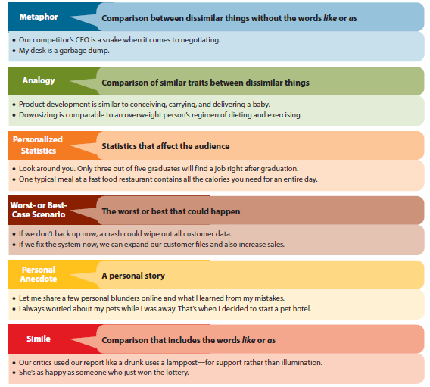
Techniques for Effective Imagery

Slide 12
Establishing Audience Rapport
Verbal Signposts
Knowledgeable speakers help the audience recognize the organization and main points in an oral message with verbal signposts. They keep listeners on track by including helpful previews, summaries, and transitions.

Slide 13
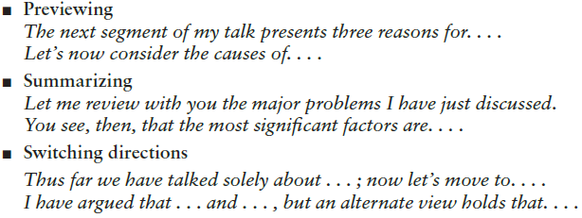
Verbal Signposts

Slide 14
Establishing Audience Rapport
Nonverbal Messages
How you look, how you move, and how you speak can make or break your presentation.

Slide 15
Establishing Audience Rapport
Suggestions for Nonverbal Messages:
Look good.
Animate your body.
Punctuate your words.
Get out from behind the podium.
Vary your facial expression.

Slide 16
THANK YOU!

